Slide 1
Fundamental Data Types

Slide 2
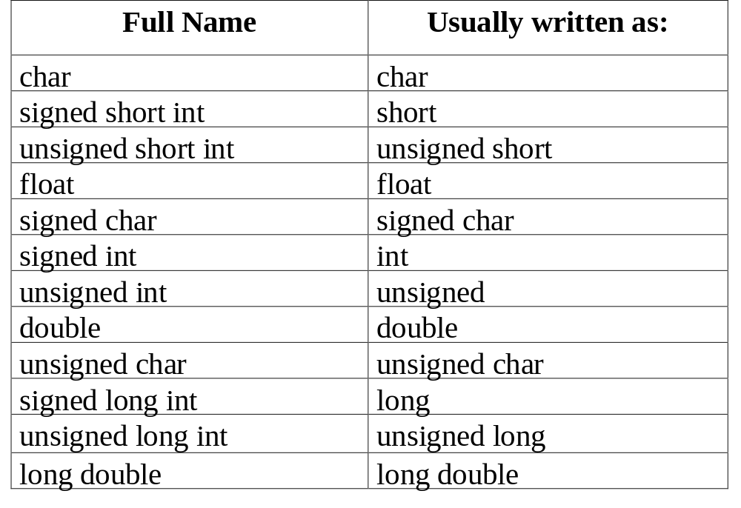
Fundamental Data Types

Slide 3
A Review of Decimal Numbers
Decimal numbers are strings of 0’s through 9’s, 90 is a different number than 09 because of the order of the digits.
In decimal numbers, the rightmost digit is the “one’s place”, as we move to the left we find digits in the “ten’s place”, then the “hundreds’s place” and so on.
When we count in decimal, we start with 0 and just change the last digit until we use all 10 decimal digits. There are ten digits, so we can store the ten numbers ( 0 - 9 ) in one digit.
When we run out of decimal digits, we move to the “tens place” and write a 1, then start over with a zero in the ones place. Thus, 10 means 1 ten plus zero ones, while 732 means seven hundreds plus three tens plus two ones.

Slide 4
Binary numbers
Binary numbers are strings of 0’s through 1’s, 10 is a different number than 01 because of the order of the digits.
In binary numbers, the rightmost digit is the “one’s place”, as we move to the left we find digits in the “two’s place”, then the “four’s place” and so on.
When we count in binary, we start with 0 and just change the last digit until we use all 2 binary digits. There are two digits, so we can store the two numbers ( 0 - 1) in one digit.
When we run out of binary digits, we move to the “two’s place” and write a 1, then start over with a zero in the ones place. Thus, 10 means one 2 plus zero ones so represents the same number as the decimal digit 2.
In binary 732 is written as 1011011100₂. This represents:
1 x 2⁹ + 0 x 2⁸ + 1 x 2⁷ + 1 x 2⁶ + 0 x 2⁵ + 1x2⁴ + 1 x 2³ + 1 x 2² + 0 x 2¹ + 0 x 2⁰
this is the unique representation for this number in binary.

Slide 5
Octal and Hexadecimal Numbers
We have seen binary strings represent numbers in “base-2”.
Octal numbers represent numbers in “base-8”.
  The rightmost digit is in the “ones” place, to its left is the “eights” place, then the “sixty-fours” place. Thus, the octal string for the decimal number 46₁₀ is 56₈ ( i.e. 5 * 8 + 6 ).
  Each octal digit tells us about 3 binary digits. In the case of 56₈, the 5 is written as 101₂, while the 6 is written as 110₂. Check for yourself but 56₈ in binary is 101110₂. Three octal digits can represent one byte.
  If you write a number in C with a leading 0, it is assumed to be octal.
    011 actually represents 1x8+1, or more simply the number 9.
Hexadecimal numbers represent number in “base-16”.
  The rightmost digit is the ones, to its left is the “sixteens” place, etc. The number 46₁₀ in hexadecimal is 2E₁₆ . The 6 digits after 0-9 are generally written as a,b,c,d,e,f or more commonly A-F.
  Hexadecimal numbers map four binary digits to one digit, two hexadecimal digits can represent the 8 bits in a byte. 2E₁₆ =00101110₂.
  If you write a number in C with a leading 0x, it is assumed to be hexadecimal . 0x11 actually represents 1x16+1 which is 17.

Slide 6
The octal dump command (od)
On UNIX systems the od command converts an input file to octal and types it on the terminal. To use it, at the command line enter:
od -bc
  The program will then wait for your input, type some stuff, including some new lines, when you are bored with typing enter the EOF character (^D), the octal representation of the characters your represented will be typed.. Example type the following line
    341 abc def
    You will get as output:
    0000000 063 064 061 040 141 142 143 040 144 145 146 012
    3 4 1 a b c d e f \n
    0000014
The first 8 digits are the offset within the file, its just a character counter. The rest of the line is how the text is actually stored, except it is shown in octal. The first byte has the octal numbers 063₈ and 064₈ which are 51₁₀ and 52₁₀ and represent the characters ‘3’ and ‘4’.
od -xc does the same except prints hexadecimal representations.

Slide 7
Integer Data types
Data types char, int, short, and long are all stored as binary numbers. They may be signed or unsigned.
Most modern machines use 32-bits for integers because that is their word-size. This is the smallest amount of data that is retrieved in one memory cycle.
Signed data uses one bit to record the sign of the number; by convention, the sign is stored in the first binary digit. Thus a thirty two bit word uses on thirty one bits to store the magnitude of the number and one bit for the sign.
To complement the bits of a binary string, simply change the 0’s to 1’s and vice - versa.
Given a number in binary, we can find its twos-complement. This is simply found by complementing each bit in the bit string for the number and adding one. This is the method most computers use to store negative numbers, I. E. to store -17 they store the twos-complement representation of 17. If you add the two bit strings you get zero, and the lead bit of the string for -17 will be 1.

Slide 8
Two’s Complement Example
We will use single byte(8-bit) integers for this example:
  The number 17₁₀ has the 8-bit binary representation:
  00010001₂
  The bitwise-complement simply changes the 0’s to 1’s and vice-versa:
  11101110₂
  00000001₂ ( we add 1₂ to the bitwise-complement to get
  11101111₂ the two’s complement.)
  So -17₁₀ in 8-bit binary two’s complement notation is 11101111₂.
Now lets add 17₁₀+-17₁₀.
  00010001₂ To do this we add digits starting on the right,
  + 11101111₂ just like with decimals except we carry on 2, not 10
  100000000₂
  We lose the lead bit since we only have 8-bits to work with. So we are left with: 17₁₀ + -17₁₀ = 00000000₂. Neat, huh!

Slide 9
Characters and the data type char
Character data is encoded when stored in computers.
  Examples
    8-bit ascii character set has 256 different characters in 8-bits.
    7-bit ascii characters have 128 different characters in 7-bits.
    EBCDIC is an alternate chraracter coding also using 8-bits to represent 256 characters.
Character data can be stored in any data type in C that can hold integers.
  long, short, int, and char can all be used for character information.
What is actually stored is the integer representing the character’s position in the codeset.
  e.g. ‘ ’ is 32 in 7-bit and 8-bit ascii and is 64 in EBCDIC.
  The last 8-bits of the integer data type will contain the value representing the character. Any leading bits will be zeroes.

Slide 10
Integer data types
1. (signed) char 2. (signed) short int
3. (signed) long int 4. (signed ) int
These types are all stored as binary numbers. The differences is the number of bits used and whether the leading binary digit signifies the sign. For character data, as we have seen, we store the binary number identifying the character in the character set (usually 8-bit ascii). Thus we store the binary number representing a 97 to store the character ‘a’.
You can tell the compiler to store 127 as an int by writing 127, as an unsigned long by writing 127UL, as an unsigned int by writing 127U, or as a long by writing 127L. The U suffix means unsigned, the L means long.

Slide 11
How big an integer can we store?
For character data, eight bits are always used.
Shorts are usually stored in 16 bits. (-32,768 to 32,767)
Longs are usually stored in 32 bits. (-2,147,483, 648 to 2,147,483,647).
For int’s the word-size of the machine is used. (Most often this is 32 bits, but is often only 16 bits.). Thus the range of possible int’s will vary by machine.
The number of bits for int, short, and long, is not guaranteed in C, so it will vary by the type of computer. What is guaranteed is that the number of bits for a short is less than or equal to the number of bits for an int which is less than or equal to the number of bits for a long.

Slide 12
Floating Point Numbers
Floating point numbers are in scientific notation:
  There is a mantissa. (Significant digits of the number)
  There is a base that will be raised to the power exponent and multiplied by the mantissa part.
  There is an exponent (The power of the base by which the number given by the integer and fractional part is to be multiplied.)
Example:
  If 10 is taken as the base, 140.32 can be represented as .14032 x 10³ in scientific notation. It will be stored with exponent 3, and mantissa 14032.
  A generic way to write this number as a bit string that corresponds to how it is stored is:
  0 000011 0011011011010000
  This represents the sign, the exponent, and the mantissa. Note in most architectures, the base is 2, and the parts of the number are store in binary. Hexadecimal representation is often used, here it is 0 03 36d0

Slide 13
Floating Data Types
float, long, and long double are the floating data types.
The floating data types store the exponent and the mantissa, the base is fixed by the type of computer. In most computers today, 2 is the base of the exponent.
The sign always occupies one bit, usually the leftmost one.
The number of bits in the exponent and the mantissa is not guaranteed by the language. What is guaranteed?
  doubles will have at least as many bits as floats
  long doubles will have at least as many bits as doubles.
The working type (default) in C is double, when writing a constant you can change its type with the suffixes F or L. E.g. 3.7F is a floating point constant, 3.7L is a long double constant.
The representation of floating point numbers varies with machine manufacturer.

Slide 14
IEEE 754 Standards for floating-point representation
A 32 bit floating-point number has 23 bits for the mantissa, 8 for the exponent, one for the sign. (In C this is commonly a float…)
  The exponents are between -126 and 127.
  the size of the mantissa allows for the storage of 7 significant decimal digits.
  Two bit patterns of the exponent are reserved to represent special values (0, inf, NAN). (inf is infinity, NAN means not a number, a divide by zero error case)
A 64-bit floating-point number has 52 bits for the mantissa, 11 bits for the exponent, one for the sign. (In C this is commonly a double…)
  The exponents then are between -1022 and 1023.
  the size of the mantissa allows for the storage of 15 significant decimal digits.
  Two bit patterns of the exponent are reserved to represent special values
Note: Today most machines use similar but different representations.

Slide 15
The sizeof Operator
To tell us how large an object is in C, the language provides the sizeof operator. Note this is a unary operator like minus, and has the same precedence. Example program:
#include <stdio.h>
int main(void){
char a;
int i;
long l;
long double L;
short s;
float f;
double d;
printf ("sizeof ( char ) is %d\n", sizeof (a));
printf ("sizeof ( int ) is %d\n", sizeof (i));
printf ("sizeof ( long ) is %d\n", sizeof (l));
printf ("sizeof ( short ) is %d\n", sizeof (s));
printf ("sizeof ( float ) is %d\n", sizeof (f));
printf ("sizeof ( double ) is %d\n", sizeof (d));
printf ("sizeof ( long double ) is %d\n", sizeof (L));
return 0;
}

Slide 16
Sizeof Operator example output
The previous program produces the following output on olympus with UNIX and on an Athlon based PC with Windows/ME, and a Pentium-II running Linux:
  sizeof ( char ) is 1
  sizeof ( int ) is 4
  sizeof ( long ) is 4
  sizeof ( short ) is 2
  sizeof ( float ) is 4
  sizeof ( double ) is 8
On olympus, the long double uses 16 bytes, while on the Athlon and the P-II, it uses 12 bytes. The IEEE 754 standard does not address long doubles (to my knowledge).

Slide 17
Mathematical functions
As was the case with I/O, there are no built-in mathematical functions in C. They are provided as library functions. To use mathematical functions usually you must include the -lm flag to the compiler (UNIX), on Developer Studio these are available by default.
Some available functions:
  double sqrt( double x); /* returns the square root of x */
  double pow (double x, double y); /* returns x to the yth power */
  double exp(double x); /* returns e^{x}, i.e. 2.718282^{x} */
  double log(double x); /* natural logarithm of x, (base is 2.718282) */
  double sin(double x); /* returns the sin for x in radians. */
  double cos(double x); /* returns the cos for x in radians. */
  double tan(double x); /* returns the tan for x in radians. */

Slide 18
The sqrt_pow program
#include <stdio.h>
#include <math.h>
int main(void) {
double x;
printf (“\n%s\n%s\n%s\n\n”, “The square root of x and x raised”,
“to the x power will be computed.”, “---”);
while (1) { /* do it forever--lousy comment, don’t you want to say---oh really? */
printf(“Input x: “);
scanf(“%lf”, &x); /* Note the use of %lf, %f would not work!!! */
if (x >= 0.0 )
printf(“\n%15s%22.15e\n%15s%22.15e\n%15s%22.15e\n\n”,
“x = “, x,
“sqrt ( x ) = “, sqrt ( x ),
“pow ( x, x ) = “, pow ( x, x ) );
else
printf (“ \nSorry, number must be nonnegative. \n\n”);
}
return 0;
}

Slide 19
Arithmetic Conversions
If all the values of the original types in an expression are int or can be represented by an int, the value of the expression is an int, otherwise it is an unsigned int. This behavior is called integer promotion.
Example:
  #include <stdio.h>
  int main(void){
  char c = 'Y';
  int i = 'Z';
  if ( i == ++ c )
  printf ("integral promotion occurred\n");
  return 0;
  }
Not too surprisingly, this program prints the message:
  integral promotion occurred.

Slide 20
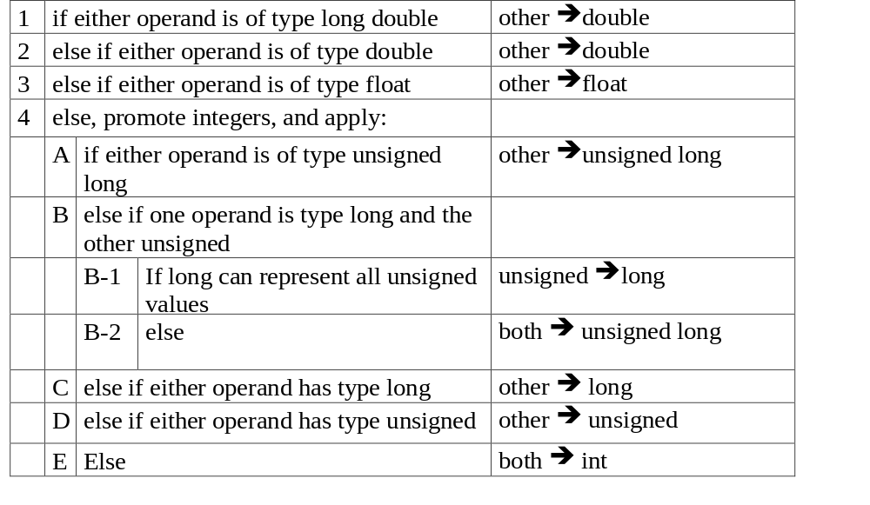
The Usual Arithmetic Conversions

Slide 21
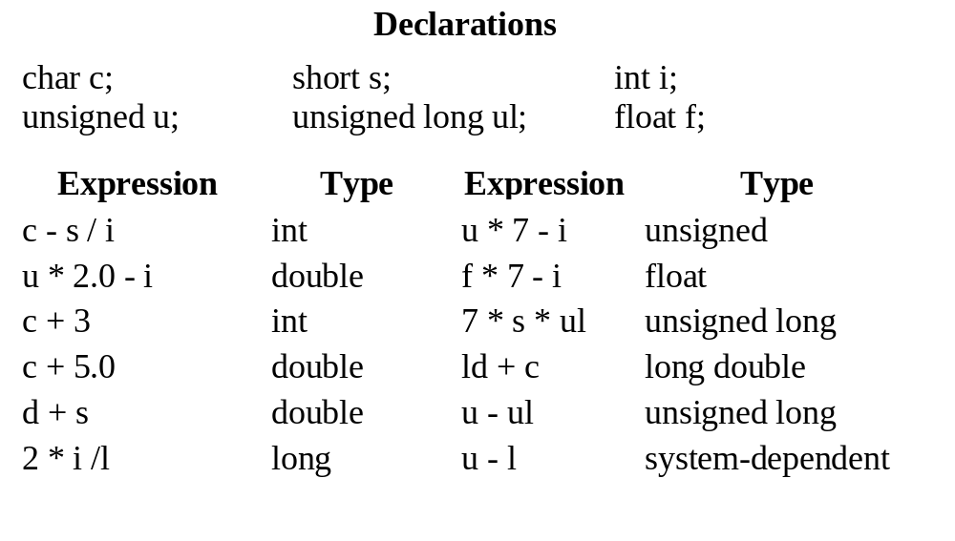
Automatic Conversion Examples

Slide 22
More facts on automatic conversions
Automatic conversion can occur in assignments.
  int i =3; double d;
  d = i;
  i will be converted to double using the table just shown as if it were an expression.
  This works well since doubles have more significant digits than ints.
  But, as we saw in assignment 1 the following loses any fractional part stored in d,
  i = d;
Automatic conversion is also called implicit conversion, widening, promotion, or coercion.

Slide 23
Casts
Just as we can use parenthesis to overrule the default precedence rules of the language. We can overrule the conversion rules by using casts. These are explicit conversions.
To cast an expression you precede the expression with the parenthesized type you wish the expression to have. Note, the thing being cast does not have its type changed.
Examples:
  (double ) i /* its as if we said (d = i ) without using d */
  (long) (‘A’ + 1.0)
  x = ( float ) ( (int ) y + 1 )
  (double) ( x = 77) but neither (double) x = 77 nor ((double ) x) = 77
The cast is a unary operator, like negation, and it has the same precedence.
  (float) i = 3 works the same as ( (float) i ) + 3

